Slide 1
Uninstalling MySQL Because of a Connection Error

Slide 2
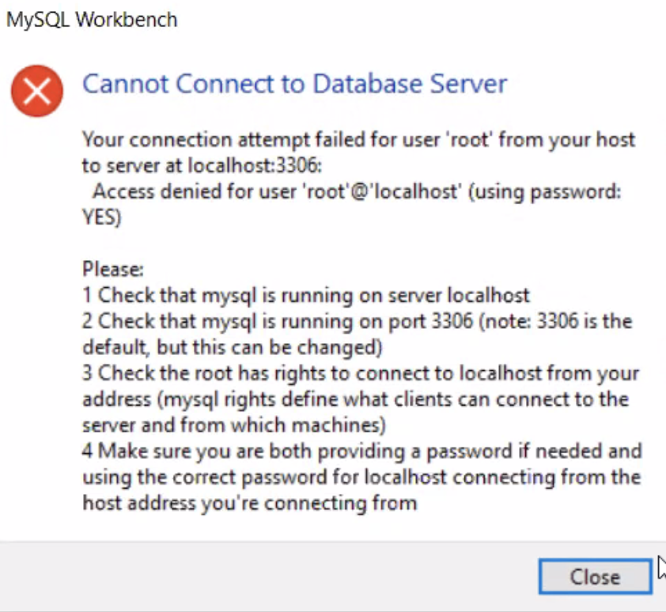
Getting this error?

Slide 3
Remove the Program
Every single MySQL file!
https://dev.mysql.com/doc/workbench/en/wb-windows-uninstalling.html

Slide 4
Go to AppData and Delete Files
C:\username\AppData\Roaming\MySQL\Workbench\
Delete all of it related to MySQL
You may have to do this multiple times

Slide 5
You know you’ve uninstalled fully when…
It doesn’t come up with a request to update
When you can put a password in for the first time

Slide 6
When you re-install….
Add an additional user and a second password

